Slide 1

Notes:
[BRIEF INTRO]
Today we are concluding Part 1 in The Sermon on the Mount series. Next Sunday is our annual Missions Sunday. The Sunday after that (Nov 23) is our Thanksgiving Service, and then the final Sunday of the month (Nov 30) we will be in Advent.
And then after the holidays and we close out 2025, we will begin the New Year by returning to this series—The Sermon on the Mount, Part 2. So, stay tuned for that.
We began this series… [NEXT SLIDE]

Slide 2
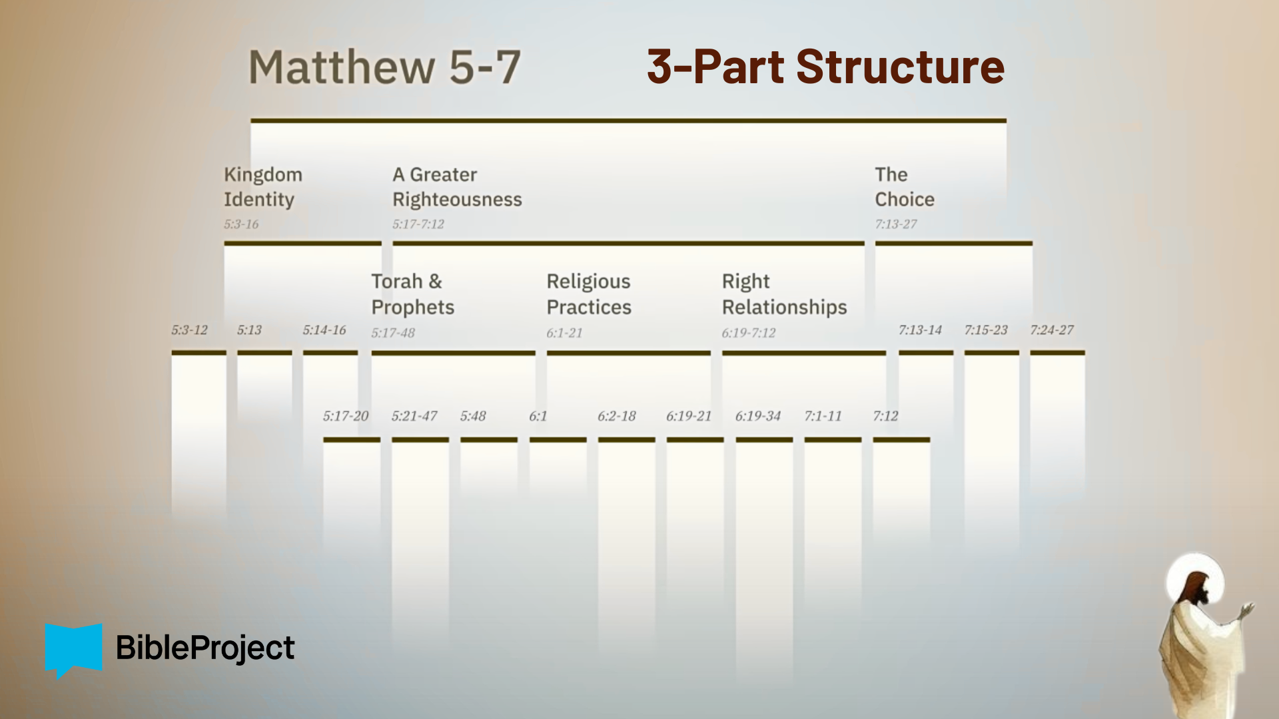
Notes:
…with the end of Jesus’ core teachings—in Matthew 7—The Choice. There in Matthew 7:13-14, Jesus says that we have a choice to walk his narrow path or not. And I’ve asked us to be mindful of that choice as we’ve made our way through his sermon verse-by-verse.
At this point, we’ve heard Jesus invite us into the ”good life” of the Kingdom with the beatitudes and then to discover a “greater righteousness” as we seek to love God, our neighbors, and our enemies in the way of Christ. And last week we heard the last of Jesus’ interpretations of Torah in chapter 5, revealing how he fulfills the Law and the Prophets.
In this final message of our fall series, we will begin chapter 6 and hear how Jesus wants us to consider what it looks like to live out a greater righteousness as his disciples. In Matt. 6:1-18, Jesus will address three religious practices: giving, prayer, and fasting. We’re just going to focus on giving in this message, which seems timely with the holidays approaching.
If you’re taking notes, I’ve entitled this message… [NEXT SLIDE]

Slide 3
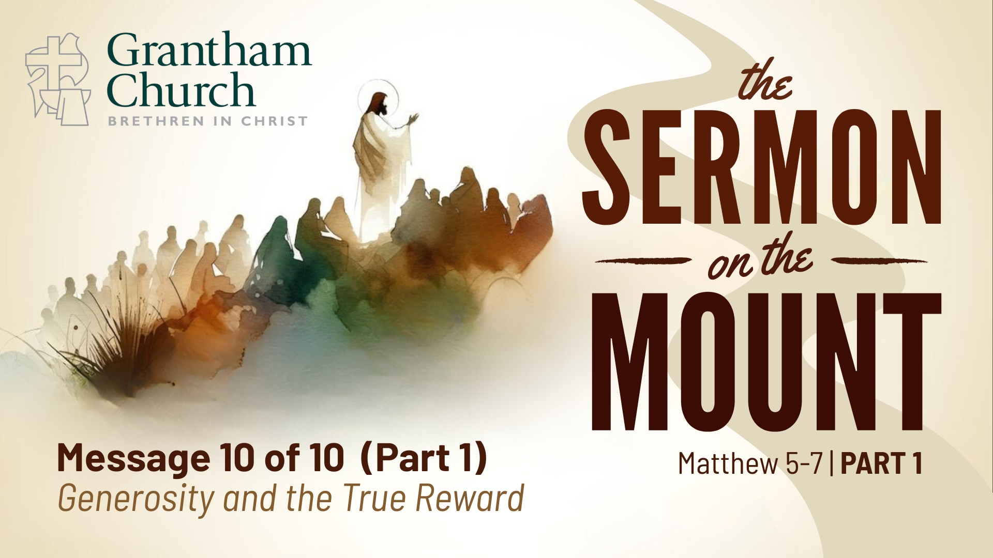
Notes:
Generosity and the True Reward.
Father, may the words of my mouth and the meditation of my heart be acceptable in your sight, O LORD, my strength and my Redeemer. Give us all eyes to see and ears to hear what you want us to see and hear this morning. Help us to discern your voice over the impulses of our flesh, the lies of the enemy, and the idols of the heart. Speak now, Lord, for your servants are listening. We pray these things in Jesus’ name… and all God’s people said… Amen.”
If you would, please grab your Bible and open up to… [NEXT SLIDE]

Slide 4
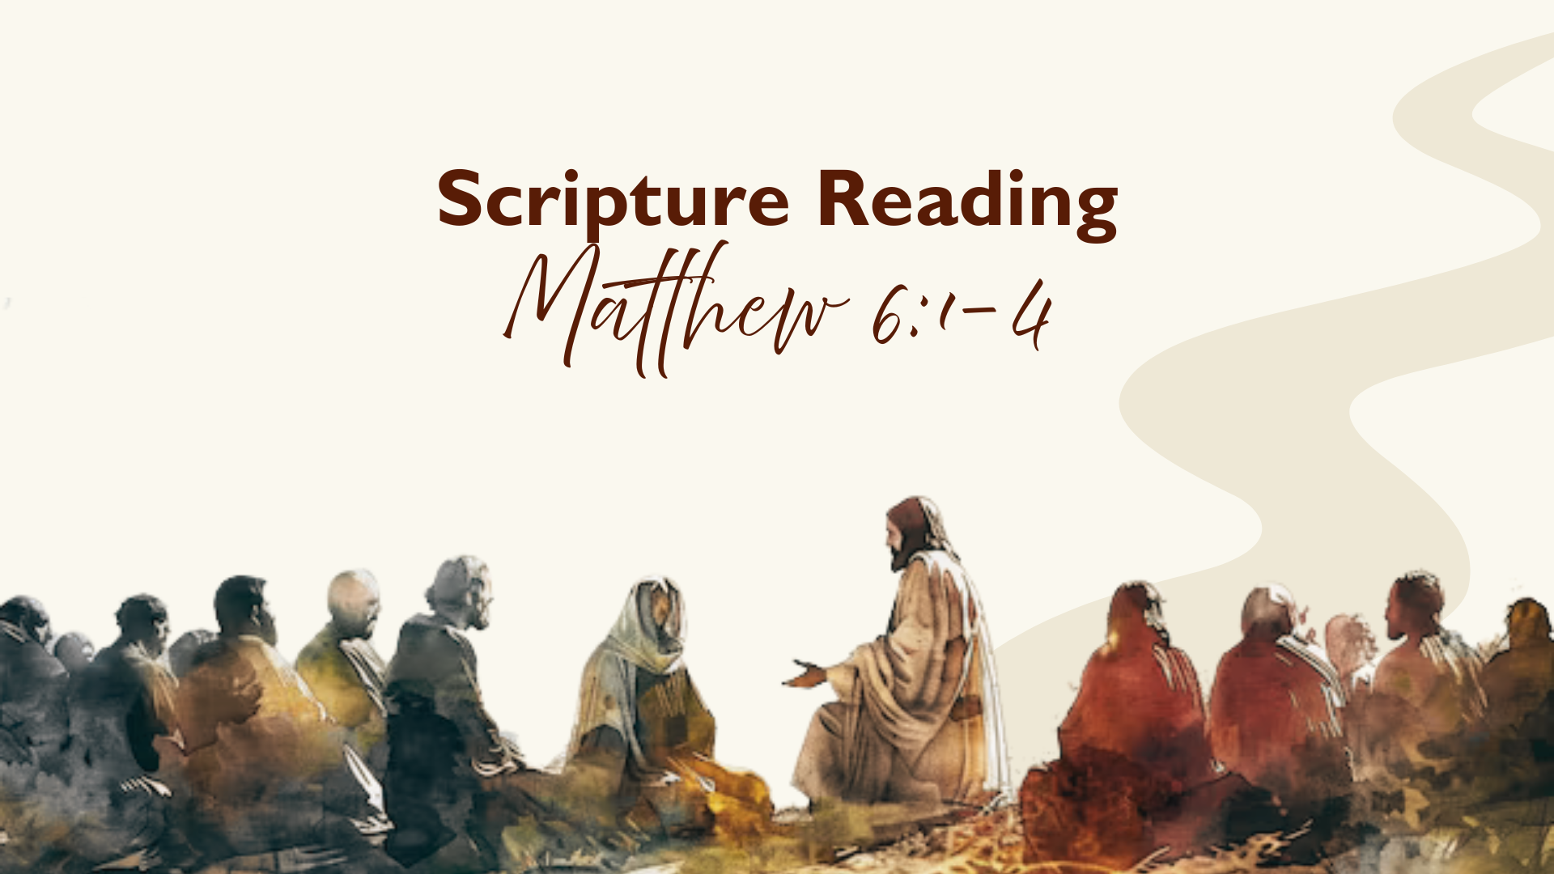
Notes:
[INVITE PEOPLE TO STAND & READ MATTHEW 6:1-4 NIV]
This is the word of the Lord. Thanks be to God. You may be seated.
You’ve likely heard this philosophical thought experiment dealing with observation and perception through this question: "If a tree falls in a forest and no one is around to hear it, does it make a sound?" Or another way to ask that question is: ”Is sound only sound if a person hears it?”
Well, as we give attention to Jesus’ teaching in Matthew 6:1-4 on how we’re to live out our righteousness through giving, I’d like to ask a different but very relevant question: “If you don’t post and announce your good works to the world through social media, did it really happen?” If we’re honest, we can be tempted to think that we need to announce our good works to the world, or it doesn’t count. And if we adopt that thinking we run the risk of our publicly announced “good works” becoming what is known as virtue signaling… [NEXT SLIDE]

Slide 5
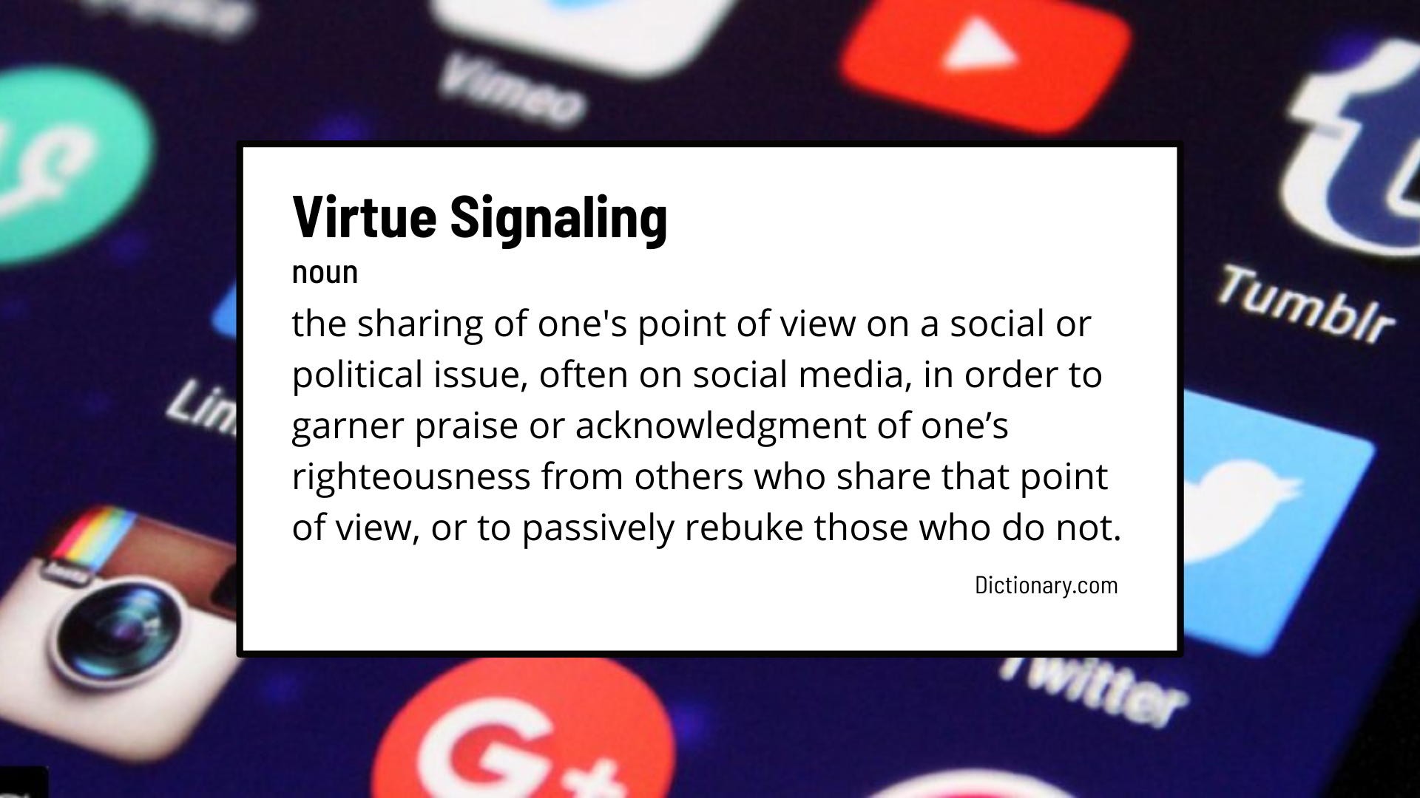
Notes:
Virtue Signaling Is “the sharing of one’s point of view on a social or political issue, often on social media, in order to garner praise or acknowledgement of one’s righteousness from others who share that point of view, or to passively rebuke those who do not.”
If you’re active on social media, it’s likely that you’ve seen this before, and maybe you’ve even done it yourself. Honestly, if you have strong feelings about your faith, politics, and care about social justice issues, it’s entirely understandable how this can happen. Which is one of the reasons why I don’t post to social media like I did some years ago. Because I felt the pull of this and in time saw how toxic it is to our relationships, conversations, and culture. And so, when I do post anything today, I try to be extremely careful in how I do it.
And based on what Jesus says in our Scripture Reading for today, I think that’s what he would want us to do. Let’s look again at our passage and walk through it verse-by-verse. How does the Lord want us to show our love of God and neighbor? [NEXT SLIDE]

Slide 6

Notes:
[READ VERSE 1]
Let’s unpack this verse… [NEXT SLIDE]

Slide 7
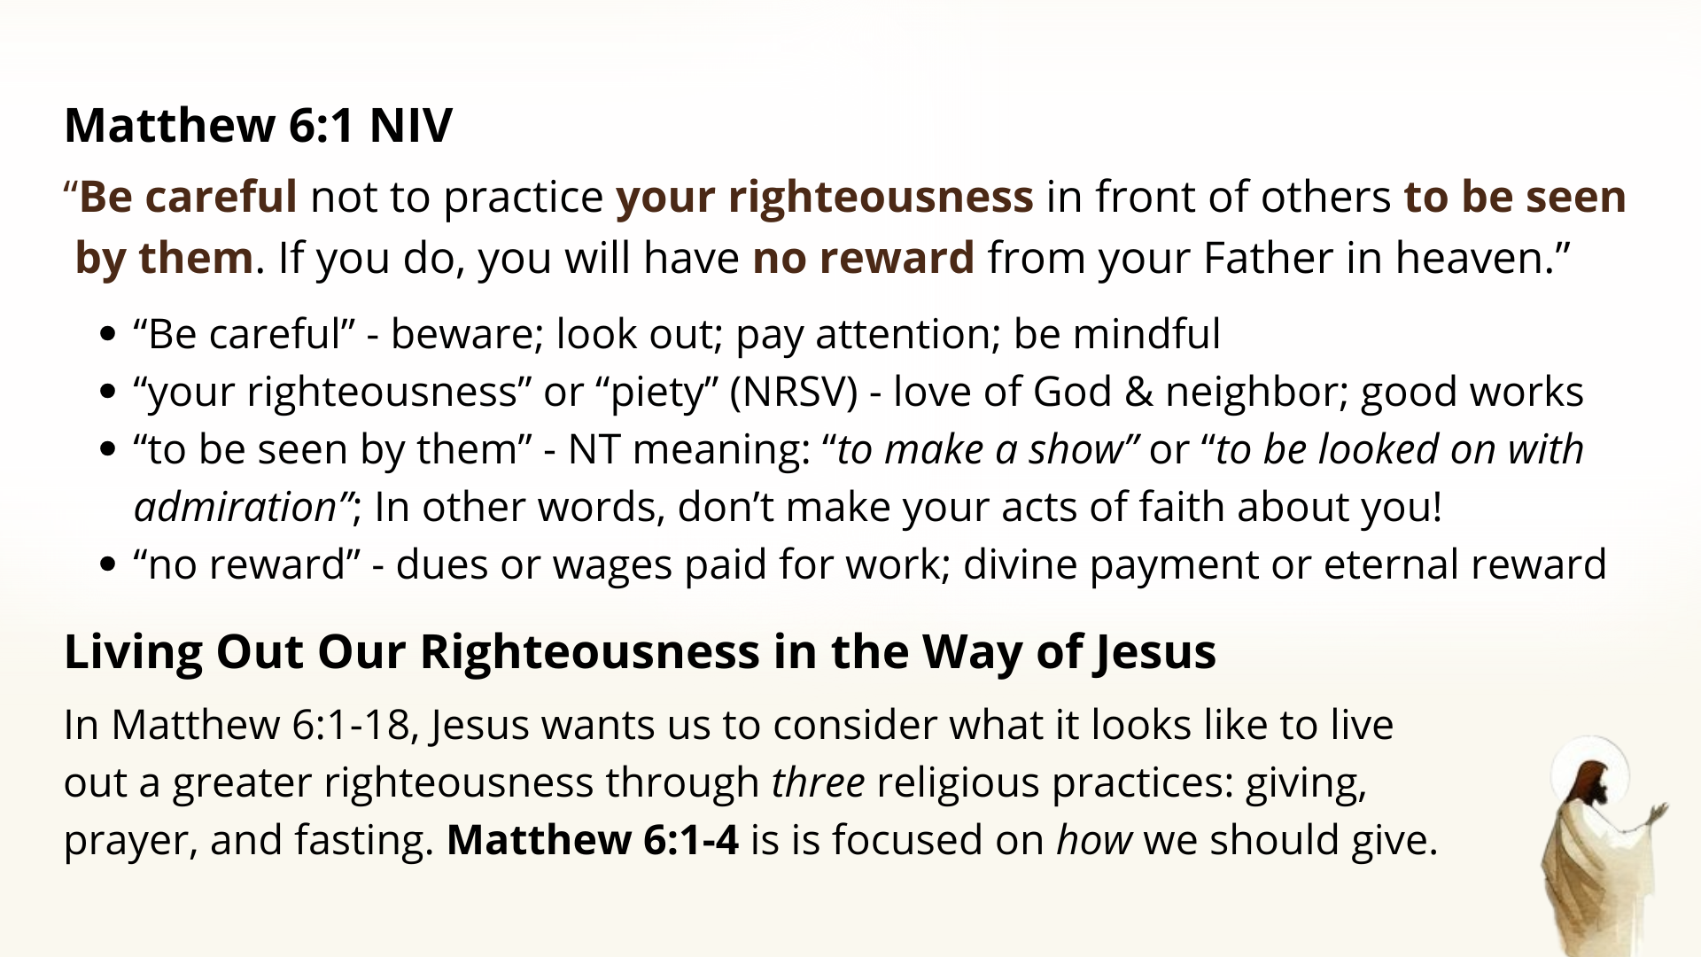
Notes:
[READ SLIDE & COMMENT]
And NT scholar Scot McKnight says that Matthew 6:1 is a thesis statement for how Jesus wants us to live out our righteousness… [NEXT SLIDE]

Slide 8
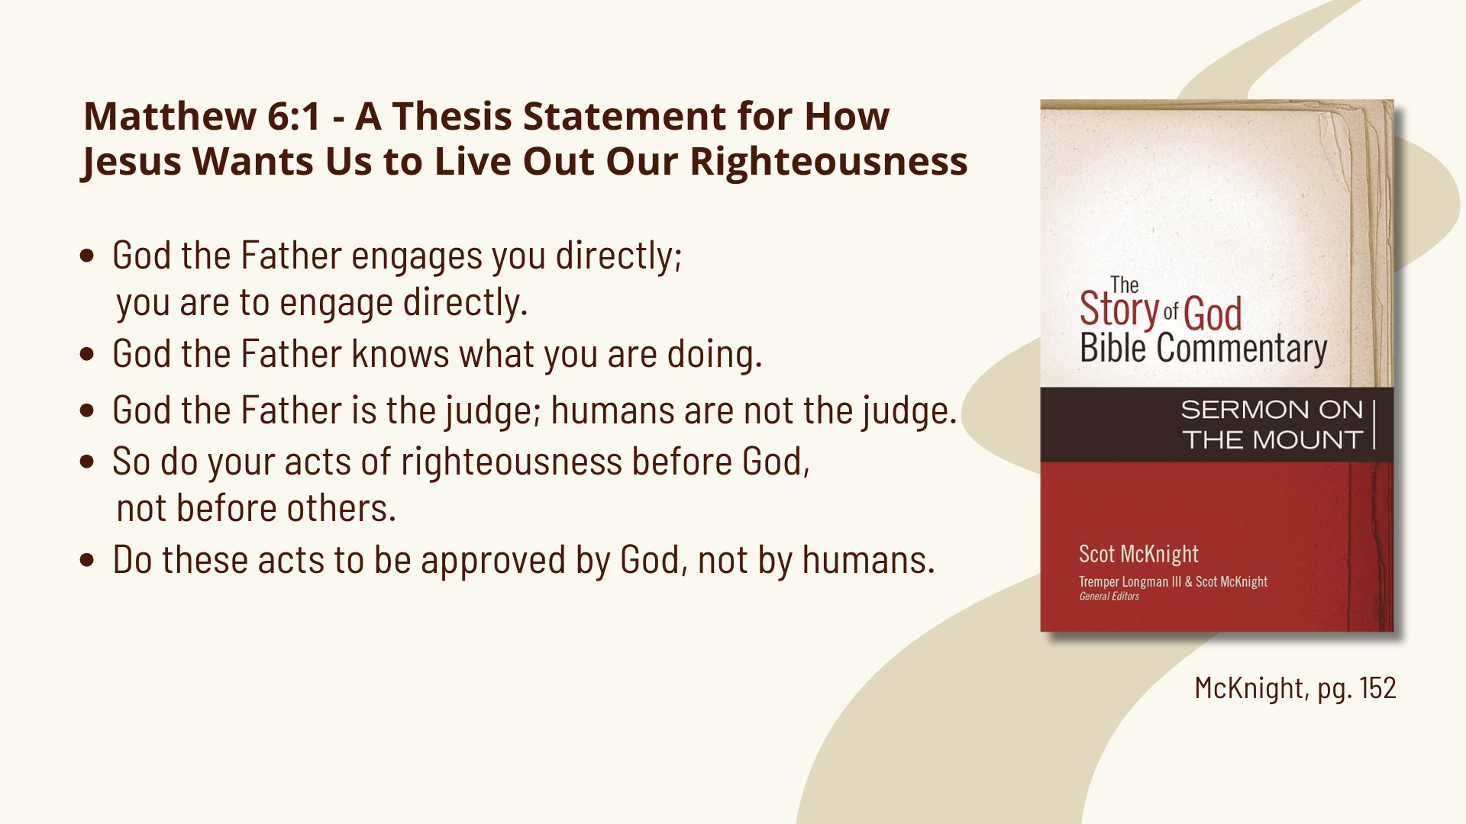
Notes:
McKnight says…
God the Father engages you directly; you are to engage directly.
God the Father knows what you are doing.
God the Father is the judge; humans are not the judge.
So do your acts of righteousness before God, not before others.
Do these acts to be approved by God, not by humans.
And then Jesus shares what this looks like with the first of three religious practice. Look at verse 2… [NEXT SLIDE]

Slide 9
Notes:
[READ & COMMENT]
v. 2 – “give to the needy” – giving to the poor or “almsgiving” was a common religious practice among faithful Jews; God wants his people to care for those in need (e.g., Acts 3 – Peter and John going to the Temple)
hypocrite – in the Greco-Roman world, this word was used to describe an actor in a play; we often think of a hypocrite as someone whose actions don’t match with what they say, but in the NT, it is someone who does the right thing but with the wrong motive; in that way they are pretending or taking on a role; but it’s not who they are underneath; they are putting on a front (mask) for those watching
v. 2b – in other words, the honor and praise of this world is all they’re going to get
v. 3-4 – “left hand… right hand” – is a hyperbolic metaphor for saying don’t be self-conscious in your giving—have a holy unawareness—for (as John Stott writes) ”our self-consciousness will readily deteriorate into self-righteousness. And that can show up in a variety of ways; one of which being that you will think you are so much better because you’ve convinced yourself that you care so much more than others. That’s why Augustine wrote: “Do not let your desire for human praise mix with your consciousness” when you give and serve others.
Of course, that’s not always easy, which is why Jesus is saying that if you struggle with this (and you’d need to be really honest with yourself), then a full-proof way to give out of love and for the right reasons is to do it without letting anyone know you’ve done it. And Jesus’ ultimate concern here is what it does to your soul when your motives are mixed with your flesh, and the eternal consequences that come when we live like the hypocrites.
v. 4b – “The Father… will reward you” – in Matthew’s gospel alone, Jesus talks about our reward over a dozen times, and it’s pervasive throughout the NT. What is this reward? Well, the true reward is not the admiration of others (that is temporary and fleeting, btw), but the deepening of our understanding and experience of God’s love and generosity; It’s the joy that comes with sharing in the uninterrupted flow of Trinitarian love through you to others; It’s the satisfaction we feel when God alone is pleased with our giving and service. But it’s also the rewards and treasures stored up in heaven, which we can only speculate about.
So, we don’t want to live like those who give and serve to simply assuage any feelings of emptiness and need for affirmation, lest we forfeit our true reward. Listen to this quote from Rich Villodas in his book, The Narrow Path… [NEXT SLIDE]

Slide 10
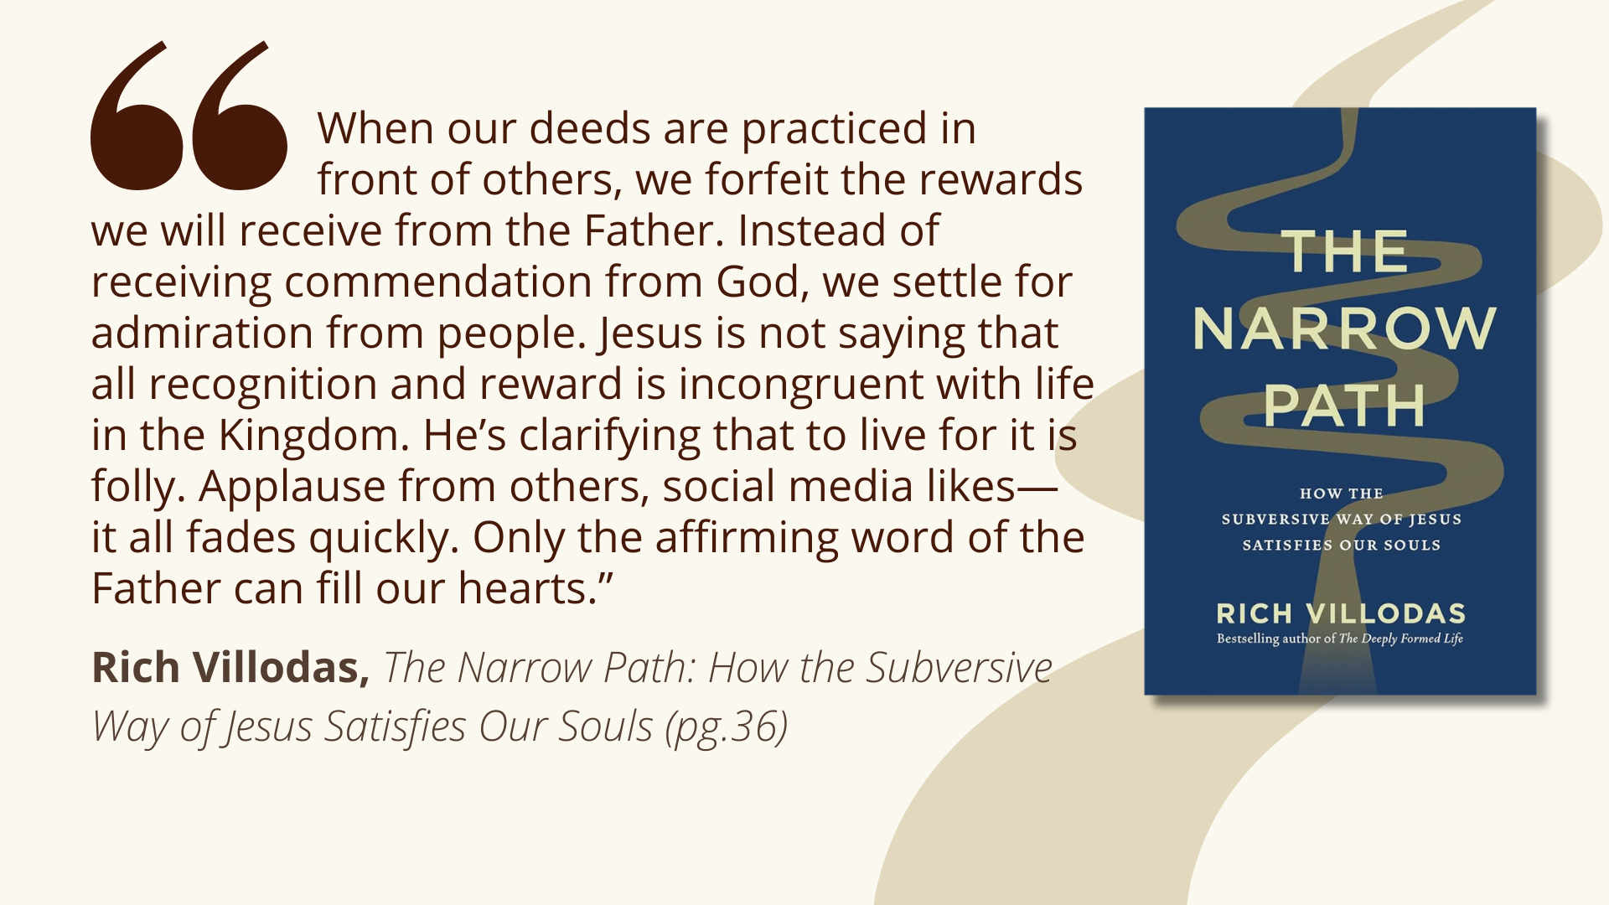
Notes:
[READ QUOTE & COMMENT]
Remember, Jesus told us earlier in Matt. 5:13-16 to let our light shine. People should see our good deeds. And public displays of generosity can inspire generosity in others, no doubt. But Jesus tell us to be careful and guard our hearts when we do it. Don’t do it to be seen; to get honor, and to meet a selfish need of yours.
I know this may not be easy for us, but let’s think about some of the ways we give of our time, talents, and treasure to be seen today. Here are a few examples of how we often do this… [NEXT SLIDE]

Slide 11
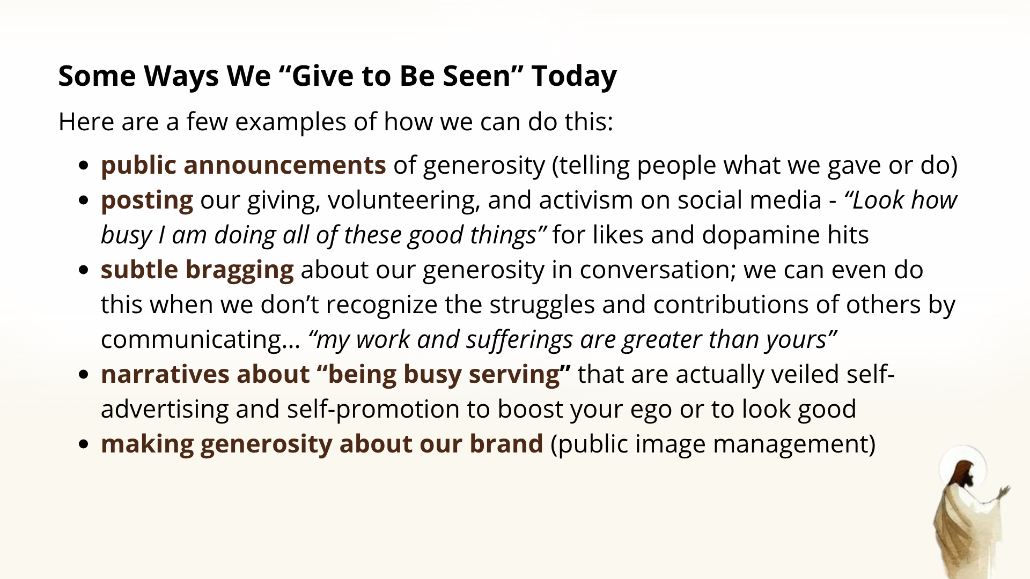
Notes:
public announcements of generosity (telling people what we gave or do)
posting our giving, volunteering, and activism on social media - “Look how busy I am doing all of these good things” for likes and dopamine hits
subtle bragging about our generosity in conversation; we can even do this when we don’t recognize the struggles and contributions of others by communicating… “my work and sufferings are greater than yours”
narratives about “being busy serving” that are actually veiled self-advertising and self-promotion to boost your ego or to look good
making generosity about our brand (public image management)
I know this isn’t the most joyful exercise, but for the sake of Christ and our discipleship, let’s do some inner reflection with the following questions…[NEXT SLIDE]

Slide 12
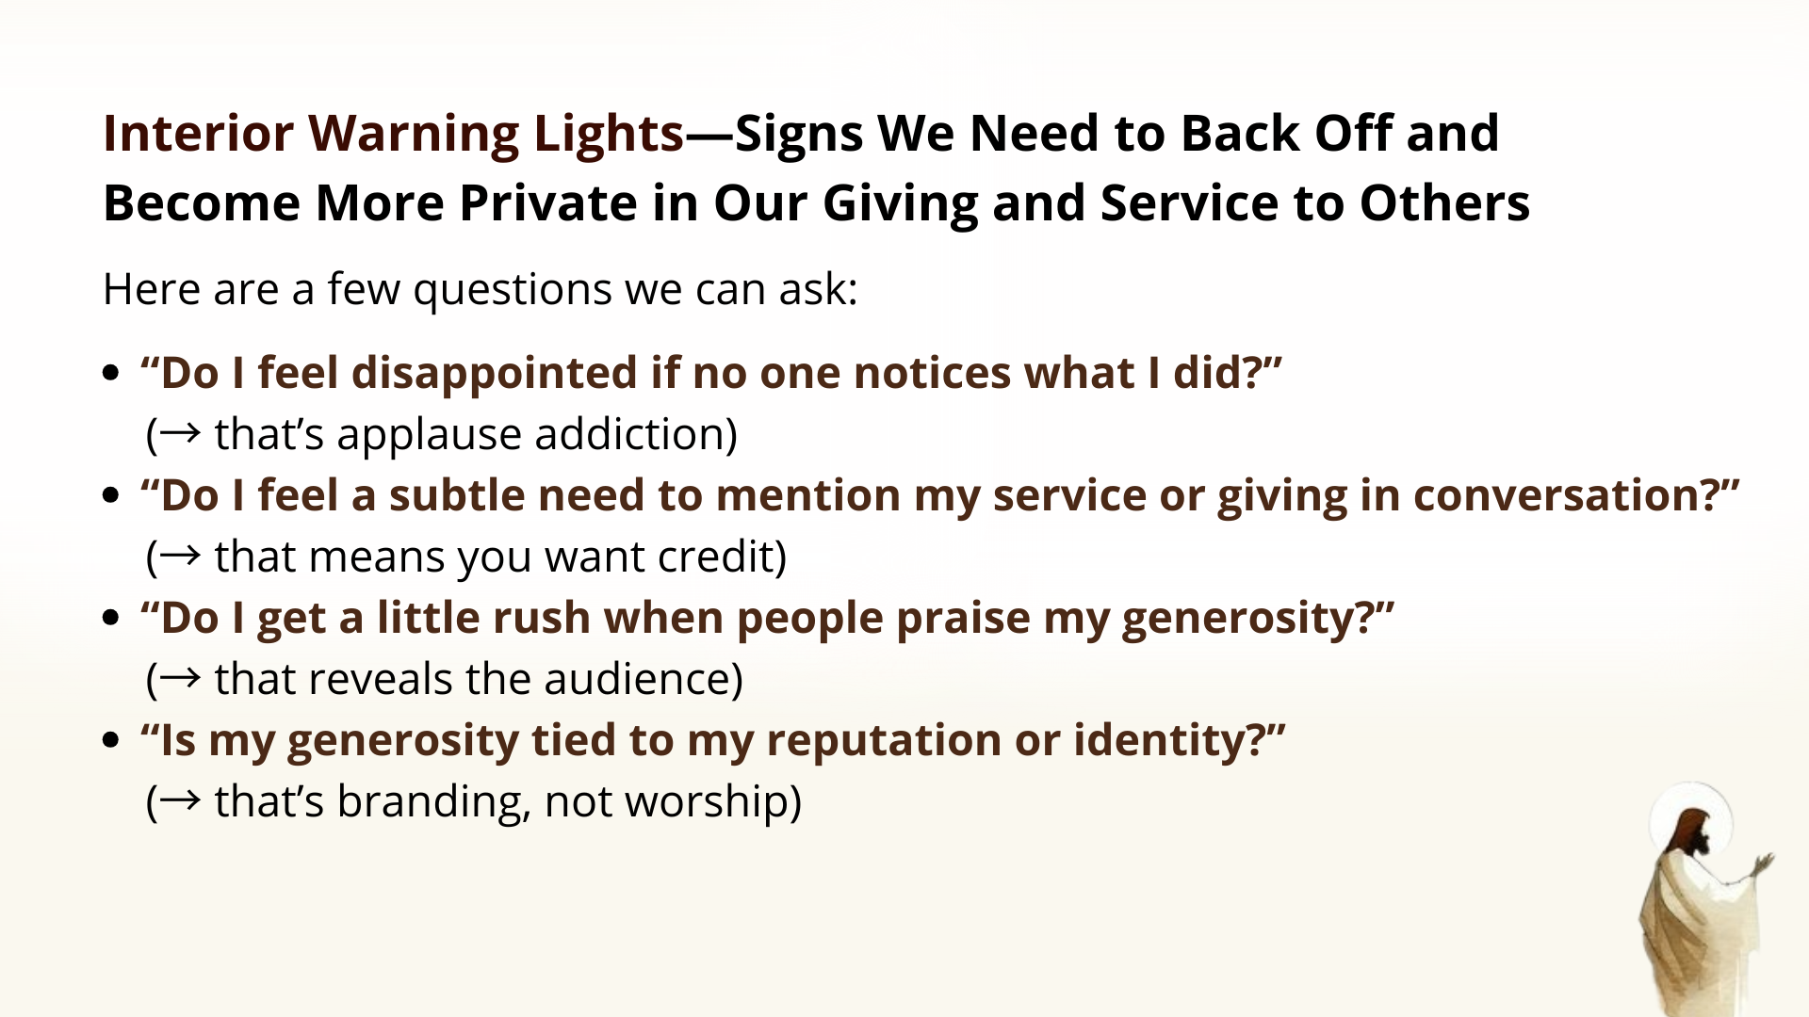
Notes:
Signs We Need to Back Off and Become More Private in Our Giving and Service to Others [READ SLIDE & COMMENT ON EACH QUESTION]
Church, the reward of the Kingdom is God himself — not people thinking well of you. So, when visibility and the need to be seen by others becomes the motive, Jesus says, it’s time to work behind the curtain. When we are content to give quietly — without telling anyone — we know we’re giving and serving for the right reason.
So, how should we give? Well, we can already hear Jesus telling us to give with a holy unawareness; to give and serve before an audience of One. Now listen to what the Apostle Paul says about how we should give… [NEXT SLIDE]

Slide 13
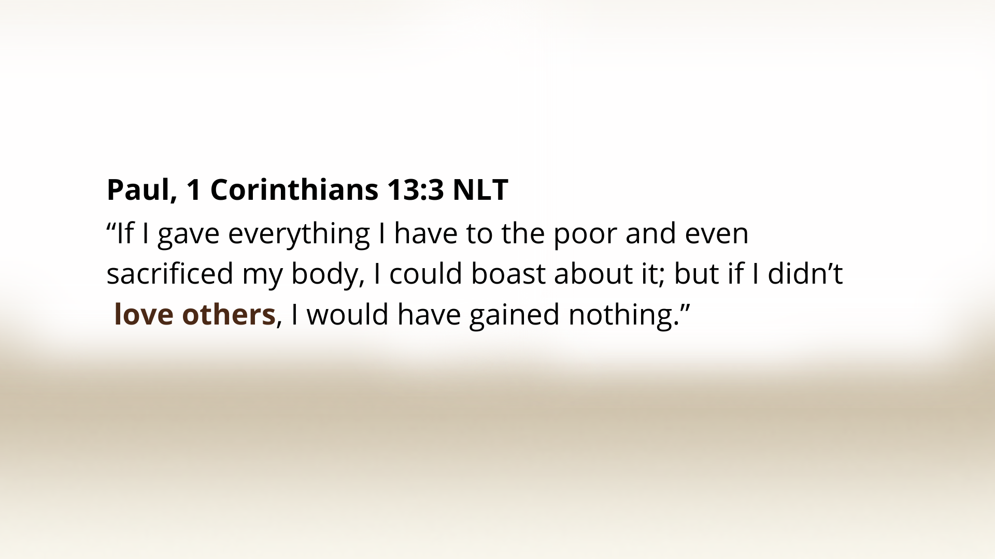
Notes:
[READ VERSE & COMMENT]
Who are the ”others” we should love? Well, first, the people we’re giving to, of course. Notice, the motivation is love. And we’re motivated by love because we are in touch with God’s love for us; and the experience of that love drives us to love others
But Paul also leaves this wide open for everyone else. I hear him saying, you can be a big giver, but if you’re a self-righteous jerk; if you’re prideful and arrogant; and if you’re unloving to certain people in your life, then you reveal that something else is at work in your heart; Give all you want; if you’re not loving, the giving is really all about you.
And then in 2 Corinthians 9:7, Paul writes… [NEXT SLIDE]

Slide 14
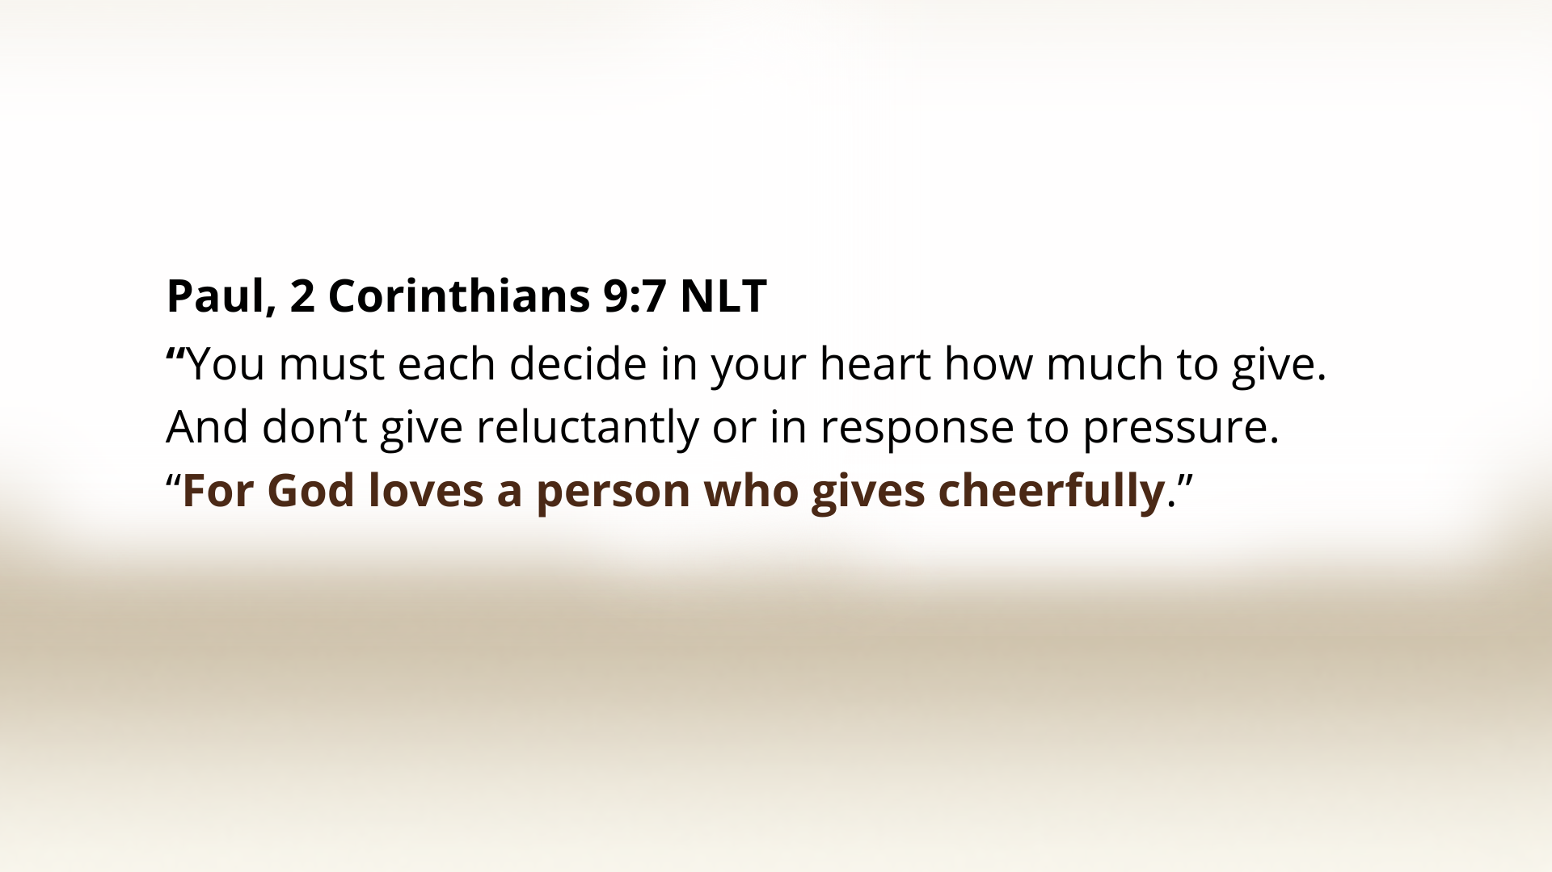
Notes:
[READ VERSE & COMMENT]
So, our motivation is love. And as Paul is saying here, it should be with a glad, willing heart. Don’t give because you feel you have to; and don’t give “reluctantly”… In other words, don’t make it like God has to pry it from your hands. Rather, give freely with a joyful heart.
Now, consider everything we’ve heard and let’s sum up what we hear Jesus saying in Matthew 6:1-4 and consider three main takeaways from the message… [NEXT SLIDE]

Slide 15
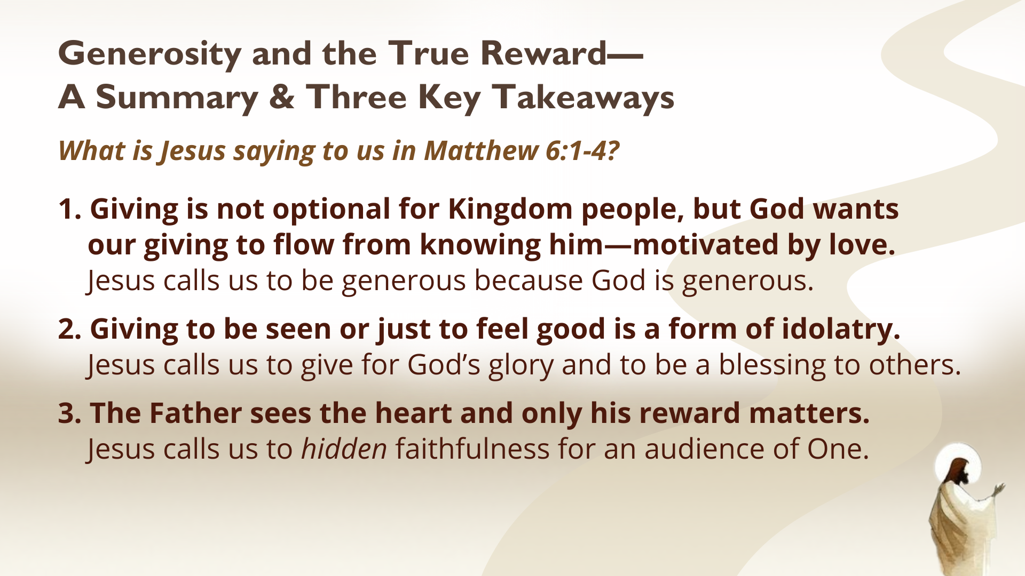
Notes:
[READ & COMMENT]
1. Giving is not optional for Kingdom people, but God wants
our giving to flow from knowing him—motivated by love.
Jesus calls us to be generous because God is generous.
2. Giving to be seen or just to feel good is a form of idolatry.
Jesus calls us to give for God’s glory and to be a blessing to others.
3. The Father sees the heart and only his reward matters.
Jesus calls us to hidden faithfulness for an audience of One.
Maybe you’ve heard this story or one like it… [NEXT SLIDE]

Slide 16
Notes:
There was a man in a small Midwest town who quietly raised cattle on a family farm. He lived simply, showed up for church every Sunday, and never made a scene. But every December, certain families in the church — single moms, widows, people who were struggling financially — would find an envelope slipped under their door with hundreds of dollars in cash and nothing else. No name. No handwriting anyone could identify. Just cash. This went on for over 20 years. After he died, the pastor learned from the man’s accountant that every December he sold one of his calves, took the cash, and divided it up among families in need. His own children didn’t even know. He never once told a soul. Friends, he lived Matt. 6:1-4. He gave because of a generous Jesus. And he gave so that only the Father saw what he was doing.
Brothers and sisters, let’s trust in the way of the upside-down Kingdom to advance the gospel. Let’s humble ourselves, so that the Lord may exalt us. And let’s give generously in response to God’s love in our lives. If we will do this, we will experience God’s favor and blessings, and we will be a blessing to others and receive the Father’s reward. Amen?
Finally, here are some questions to help us reflect and respond together… [NEXT SLIDE]

Slide 17
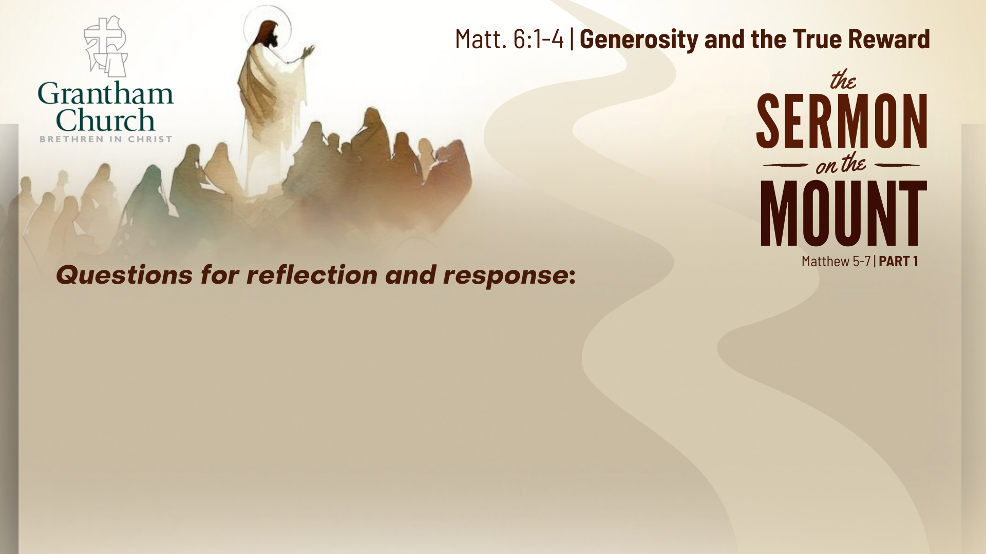

Slide 18
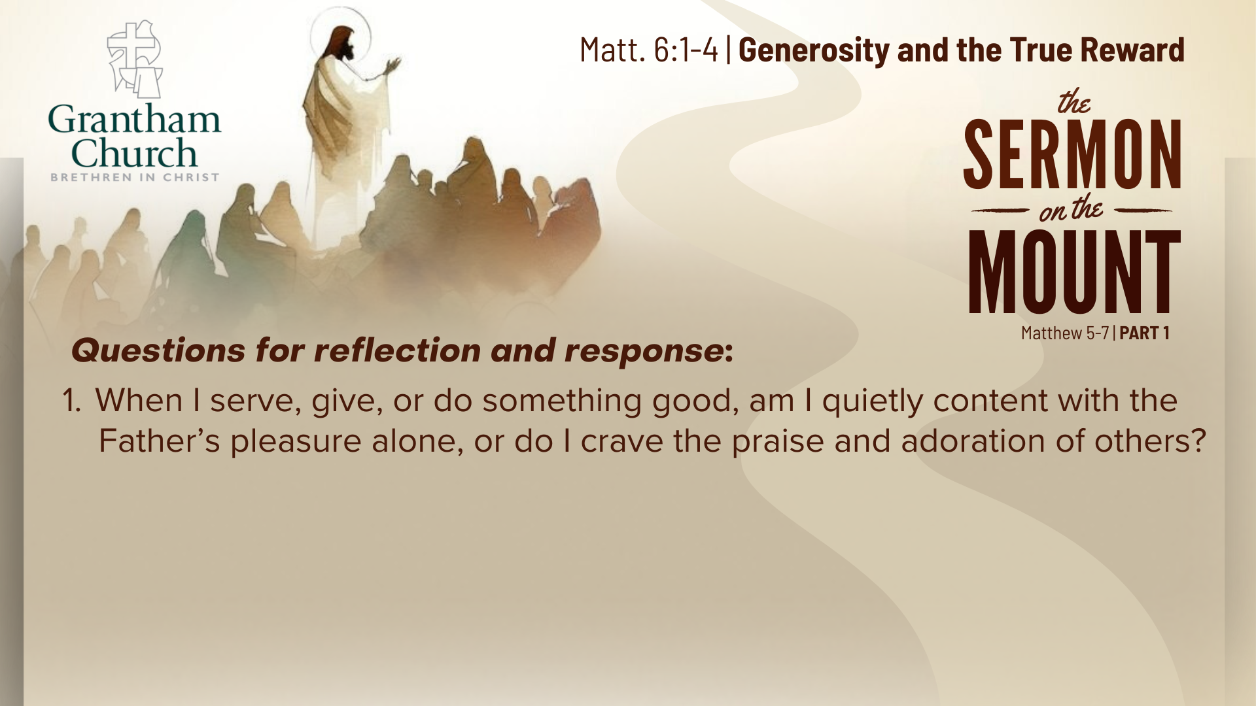

Slide 19
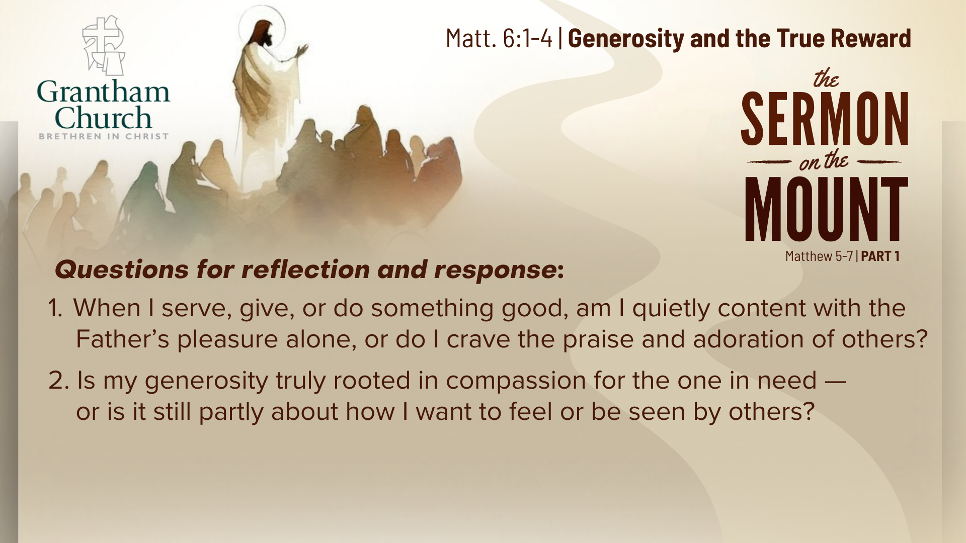

Slide 20
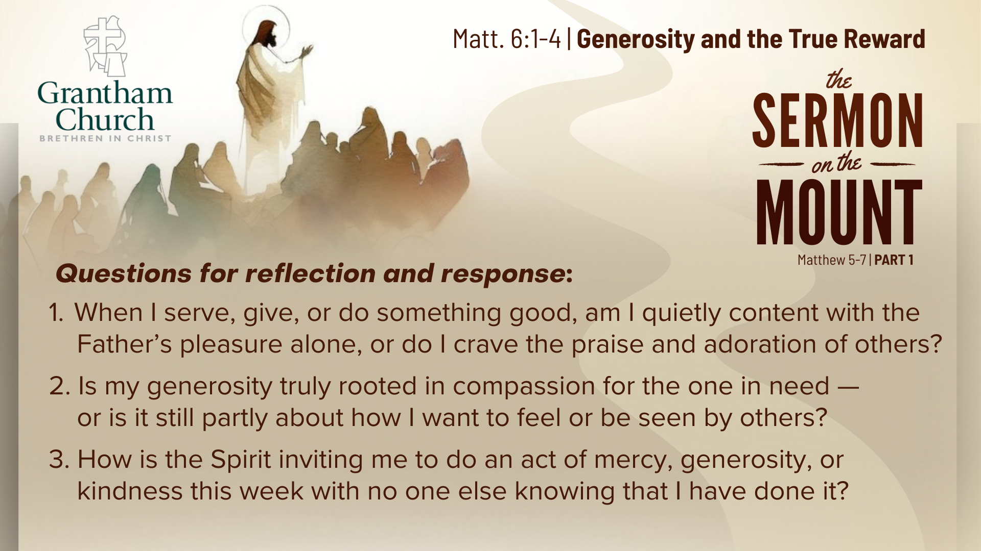
Notes:
[READ & BRIEF COMMENT ON EACH QUESTION]
When I serve, give, or do something good, am I quietly content with the Father’s pleasure alone, or do I crave the praise and adoration of others?
Is my generosity truly rooted in compassion for the one in need —or is it still partly about how I want to feel or be seen by others?
How is the Spirit inviting me to do an act of mercy, generosity, or kindness this week with no one else knowing that I have done it?
Let’s pray… [NEXT SLIDE FOR CLOSING PRAYER]

Slide 21
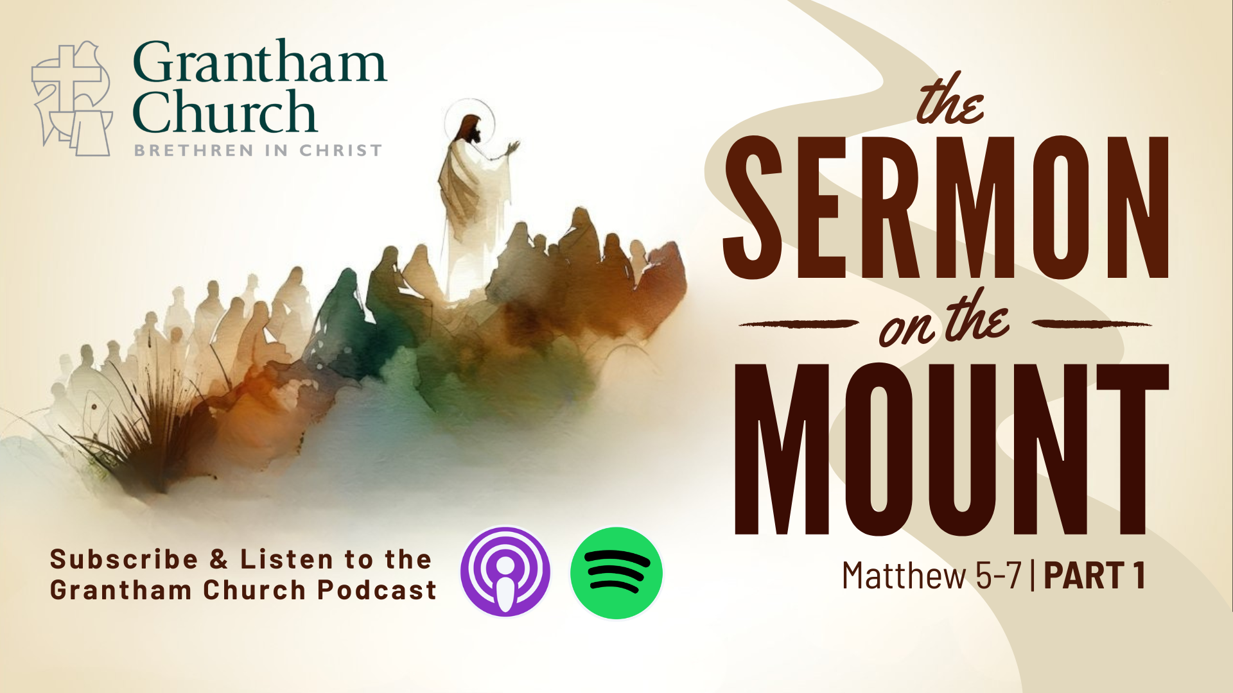
Notes:
Father in heaven, You see what no one else sees. You know the motives of our hearts. We confess that we often want to be noticed, applauded, or praised. We like to look righteous more than we like to be righteous. Cleanse us from the need to perform. Free us from the desire to impress. Lead us into the freedom of hidden faithfulness. Teach us to give for love’s sake, not for reputation. Teach us to serve because You first served us. Make us generous in secret — confident that You see, You know, and You reward. May our lives be lived for an Audience of One —and may the quiet smile of our Father be enough for us. In Jesus’ name, Amen.
Benediction
Brothers and sisters, you have heard the words of Jesus and the call to follow him. The path is narrow, but it leads to life. Remember that Christ walks with you, the Father surrounds you, and the Spirit empowers you. Therefore, go in peace, to love and serve the Lord. Amen.

